Slide 1




2027 Plan Year
Open Enrollment Guide
Postdoctoral Benefit Program

Slide 2

Table of Contents
Benefits Overview……………………………………………. | 3
Open Enrollment & What’s New..…….………………. | 4
Open Enrollment Process …………...…………………… | 5
Benefit Program Website Resources ...…………….. | 6
Important Medical Plan Information ……………….. | 7
Glossary of Terms ……………………….…………………… | 8
Medical Plan Options ……………..………………………. | 9-10
myUHC Online Member Portal ………………………… | 11-13
Virtual Visits…………………………………………………….. | 14
When and Where to Access Care……………………… | 15
Medical Plan Wellness Programs ..…………………… | 16
Employee Assistance Program (EAP) ……………….. | 17
Dental Plan Options ..………………………………………. | 18
Vision Plan ………..……………………………………………. | 19
Basic Life | AD&D Plan ……………………………………. | 20
Income Protection – Employee Postdocs ………… | 21
Income Protection – NRSA & Direct Postdocs ….. | 22
Voluntary Life Insurance …………………………………. | 23
Voluntary Life Insurance Rates ………………………… | 24
Healthcare FSA ………………………………………………… | 25
Dependent Care ……………..……………………………….. | 26-27
Other Benefits ………...……………………………………… | 28-29
Rates and Contributions ………………………………….. | 30-32
Contact Information ...…………………………………….. | 33
2

Slide 3







BENEFITS
Gallagher Benefit Services (GBS) is pleased to administer the Northwestern University Postdoctoral Benefit Program. The Program is a comprehensive package of benefits that closely matches the benefits offered to faculty and staff.
 | Medical Insurance: UnitedHealthcare (Effective 1/1/2026) HMO and PPO Plans |  | Dental Insurance: Guardian HMO and PPO
 | Vision Insurance: EyeMed PPO |  | Life | AD&D Insurance: The Standard
 | Long-Term Disability (LTD) Insurance: The Hartford (Employee Postdocs) The Standard (NRSA & Direct Pay)
 | Extended Sick Time (EST): The Hartford Short-Term Disability (STD) Insurance: The Standard
 | Voluntary Life Insurance: The Standard
 | Flexible Spending Accounts (FSA): Inspira
3

Slide 4

OPEN ENROLLMENT—GET READY
What is Open Enrollment?
Open Enrollment is an annual period of time where you are able to make changes to your coverage that you are not permitted to make throughout the rest of the year, unless you experience a qualifying event such as marriage, birth of a child, etc. The Open Enrollment period for this year will be 10/26/2026—11/13/2026. Changes made during Open Enrollment will take effect 1/1/2027. Please Note: You must renew your election to make pre-tax contributions to a Health Care FSA each year during Open Enrollment. If you don’t, your Health Care FSA pre-tax contribution amount for the next year will default to $0. Other than FSA elections (if applicable), if you are not making any changes to your benefits, NO ACTION IS NECESSARY.
Benefit Changes For Plan Year 2027 (1/1/2027—12/31/2027)
There are no benefit changes for plan year 2027. All plans remain the same: Medical insurance: UnitedHealthcare (PPO & HMO) Dental insurance: Guardian Dental (PPO & HMO) Vision insurance: EyeMed (PPO) Basic Life, AD&D, Supplemental Life: The Standard If you are satisfied with the medical, dental, vision and life insurance choices you had in plan year 2026, no action is required on the Gallagher Benefits Portal. The same plans you have will continue in 2027. If you wish to participate in the Flexible Spending Accounts offered by NU, you need to re-elect participation each year on the MyHR portal. These plans are administered by Human Resources.
4

Slide 5

OPEN ENROLLMENT—TAKING ACTION
Making Changes to Your Enrollment As a postdoc, you may need to utilize two systems, both accessed via myHR, to enroll in benefits. One system, administered by Gallagher, will allow you to enroll yourself/ your dependent(s) in Medical, Dental, Vision and Life Insurance, along with the Tobacco Attestation. The other system, administered by Human Resources, will allow you to enroll in Health Care Flexible Spending Account (FSA), Dependent Care FSA, Dependent Care FSA Match or Grant, Long-Term Disability Plans, and LegalEASE Plans (for Employee Postdocs only.) One can receive the match if eligible for Dependent Care FSA and has a household income that qualifies. One can alternatively qualify for the Grant if not eligible for the Dependent Care FSA.
To make changes to your coverage during the Open Enrollment period, log into the Northwestern University myHR portal and proceed to: 1. Select the Benefits tile in myHR Self Service. 2. Select Postdoctoral Benefit to enroll in health, dental, vision, life Insurance. 3. Select Postdoctoral Open Enrollment Elections. 4. Select Begin Enrollment from the center of the page. 5. Login as a RETURNING USER. Utilize the Forgot User ID or Password link if necessary.
Once you have logged in and are viewing the enrollment wizard, interact with the required fields and progress through the wizard in order to:
1. Switch from the HMO medical and/or dental plan to the PPO medical and/or dental plan - or vice versa. Please note: the HMO medical and dental plans are only available to postdocs residing and accessing care in Illinois.
3. Enroll or Waive coverage for you and/or any eligible dependents.
4. Attest to your Tobacco Use Status.
$50/MONTH CHARGE IS APPLIED FOR THOSE WHO USE TOBACCO OR DO NOT ATTEST THAT THEY DO NOT USE TOBACCO.
Once the enrollment wizard is complete, please confirm that you have read and understand the applicable notices, then click Finish Enrollment. An electronic version of the enrollment form will be submitted to the GBS secure website for enrollment & billing purposes. Feel free to print a copy for your records.
If you make a change to your coverage, you will receive an email confirming your 2027 coverage changes by 12/19/2026.
If you change Medical Plans, new ID cards will be mailed to your home directly from the Insurance Carrier prior to 1/1/2027.
If you are adding a dependent to your health insurance, you will need to provide documentation to prove dependency. All documents can be uploaded via the link provided in the dependent section of the enrollment wizard. Documents approved to verify dependent status can be found on the website under Dependent Verification.

Slide 6

WEBSITE RESOURCES
Provider Directories
You can find a list of providers on the GBS website via the Find a Provider tool. If you enroll in the HMO plan, you are required to select a Primary Care Physician (PCP) or else one will be assigned to you. You do not need to choose a PCP if you are enrolled in the PPO plan. To find an HMO PCP, or a PPO provider when you wish to access service, follow the instructions under Find a Provider.
Benefit Summaries
This booklet contains benefit “snapshots” of the plans offered with information about core benefits. More detailed plan documents, including full benefit summaries and summaries of benefits and coverage (SBCs), are available on the GBS website. SBCs summarize important information about medical insurance to help you learn about your benefits and compare options. On the website, click on Plan Documents Library to access detailed plan documents for all plans offered.
2027 Monthly Rates & Contributions
This information is available online under Insurance Benefits and Rates, as well as pages 30-32 of this booklet.

Slide 7

MEDICAL PLAN INFORMATION
HMO vs. PPO Medical Plan
HMO (Health Maintenance Organization)
This plan offers a broad spectrum of benefit coverage with a higher degree of managed care. Managed care is a method of healthcare delivery designed to lower costs by limiting your ability to choose providers outside of your primary care physician’s medical group (a group of physicians who have contractually agreed to share and coordinate patient care).
Under the Health Maintenance Organization (HMO) model, you must choose a Primary Care Physician (PCP) within the network. You can change your PCP up to once a month. Note: If you do not choose a PCP, one will be assigned to you.
Your Primary Care Physician (PCP) will be your first point of contact when accessing care, acting as your “healthcare gatekeeper.”
If you need to see a specialist or wish to go to an Urgent Care Center, you will need a referral from your PCP first.
The network is smaller than that of the PPO plan and limited to Illinois. The HMO does not offer an out-of-network benefit.
In the event of a life/limb-threatening emergency, the member should dial 911 and all medical care will be covered as per the plan contract. Once the patient is stabilized, the HMO may require that the patient be transferred to an in- network facility.
HMO out-of-pocket costs (i.e. deductible, co-payments, etc.) tend to be lower than the PPO plan option.
PPO (Preferred Provider Organization)
The PPO plan offers more flexibility and choice than the HMO plan because it offers both “in-network” and “out-of- network” options.
The in-network benefits (coinsurance, out-of-pocket maximum, etc.) will result in lower out-of-pocket costs than the out -of-network benefits.
The PPO Plan and the Provider agree to a "discounted fee for service" model. This means that the participating provider has agreed to provide their services at a discounted rate. Providers outside the network have not agreed to that discounted rate and typically charge a "Reasonable and Customary" fee, resulting in higher out-of-pocket costs.
Due to HIPAA (Health Insurance Portability and Accountability Act) protection laws, Northwestern and Gallagher do not have access to your medical claims information.

Slide 8
GLOSSARY OF TERMS
Deductible
A specific dollar amount that your health insurance company requires you to pay out-of-pocket each year before your health insurance plan begins to make payments for claims. Not all health insurance plans require a deductible.
Out-of-Pocket Maximum
Out-of-pocket maximums apply to all medical plans. This is the maximum amount you will pay for health care costs in a calendar year. Once you have reached the out-of-pocket maximum, the plan will fully cover eligible medical expenses for the rest of the plan year. If you see an out-of-network provider, you will still be responsible for out-of-pocket costs that are above the “reasonable and customary” fees.
Copayment
A specific charge that you pay for a specific medical service or supply, also referred to as a "copay." For example, your health insurance plan may require a $20 copayment for an office visit or brand-name prescription drug, after which the insurance company pays the rest.
Coinsurance
The amount that you are required to pay for covered medical services after you've satisfied any co-payment or deductible required by your health insurance plan. Coinsurance is typically a percentage of the charge for a service. For example, if your insurance company covers 80% of the allowable charge for a specific service, you are responsible for the remaining 20% as coinsurance.
In-Network Provider
A healthcare professional, hospital, or pharmacy that has a contractual relationship with your health insurance company. This contract establishes allowable charges for specific services. In return, healthcare providers gain patients; primary care physicians may receive a fee for each patient assigned to their care. An out-of-network provider is a healthcare professional, hospital, or pharmacy that is not part of your health plan's network of preferred (in-network) providers. You will pay more for services received from out-of-network providers because you will be responsible for costs considered above the “reasonable and customary” fees.
Claim
A request by a plan member, or a plan member's health care provider, for the insurance company to pay for medical services.
Qualifying Life Event
A life event that allows you to make changes to your insurance coverage that otherwise are only allowed during the annual Open Enrollment period. Examples of a qualifying life event include, but are not limited to, marriage, divorce, birth or adoption of a child, loss of prior coverage, relocation, and the arrival of a dependent from another country.

Slide 9

MEDICAL PLAN OPTIONS | HMO
 | HMO
 | In-Network
Core Benefits | Postdoc Pays
Deductible Single/Family | None
Out of Pocket Maximums Single/Family | Medical: $1,500 / $3,000 Rx: No separate Rx OOPM
Office Visit* | $25 / $35 Copay
Annual Wellness Visit | No Charge
Inpatient Hospital | No Copay if stay is for mental health
Outpatient Surgery | No Copay
Emergency Room | $150 Copay**
Telehealth*** | $25 / $35 Copay
Virtual Care Services**** | No Copay
Rx | $10 Tier 1 $40 Tier 2 $75 Tier 3 $125 Tier 4
*Copay waived if patient is under 19 years old
**Copay waived if admitted
***Licensed medical professional using telecommunication or information technology
****Defined as medical care provided by a third party like TeleDoc, Doctor on Demand, Amwell
UnitedHealthcare—Member Portal
myuhc.com® allows members to access a plethora of health insurance resources including digital ID cards, claims review, provider directory access and more. Please see page 11 for more information. To register for myUHC, simply: Visit myUHC.com Click Register Now or scan the QR code to download the app Use the information on your UnitedHealthcare ID card to complete the registration process Please note: HMO Plans require that you be assigned to a Primary Care Provider (PCP). If you do not designate a PCP when enrolling, one will be assigned to you based on the home address given.

Slide 10
MEDICAL PLAN OPTIONS | PPO
 | PPO
 | In-Network* | Out- of-Network
Core Benefits | Postdoc Pays | Postdoc Pays
Deductible (Single/Family) | $500 / $1,500 | $1,000 / $3,000
Medical Out-of-Pocket Maximums Single/Family | Medical: $3,000 / $8,000 | Medical: $6,000 / $16,000
Rx Out-of-Pocket Maximums | No separate Rx OOPM (included in Medical OOPM)
Office Visit** | $25 / $35 Copay | 40%***
Annual Wellness Visit | No Copay | 40%***
Inpatient Hospital | 20%*** | 40%***
Outpatient Surgery | 20%*** | 40%***
Emergency Room | $150 Copay + 20%****
Telehealth***** | $25 / $35 Copay per visit* | 40%***
Virtual Care Services****** | No Copay | 40%***
Rx | $10 Tier 1 $40 Tier 2 $75 Tier 3 $125 Tier 4 | $10 Tier 1 $40 Tier 2 $75 Tier 3 $125 Tier 4
*Certain physicians deemed “In-Designated Network” by UHC may offer additional discounts
**Copay waived if patient is under 19 years old
***After deductible has been met
****Copay waived if admitted
*****Licensed medical professional using telecommunication or information technology
******Defined as medical care provided by a third party like TeleDoc, Doctor on Demand, Amwell
UnitedHealthcare—Member Portal
myuhc.com® allows members to access a plethora of health insurance resources including digital ID cards, claims review, provider directory access and more. Please see page 11 for more information.
To register for myUHC, simply:
Visit myUHC.com
Click Register Now or scan the QR code to download the app
Use the information on your UnitedHealthcare ID card to complete the registration process
10

Slide 11


Slide 12
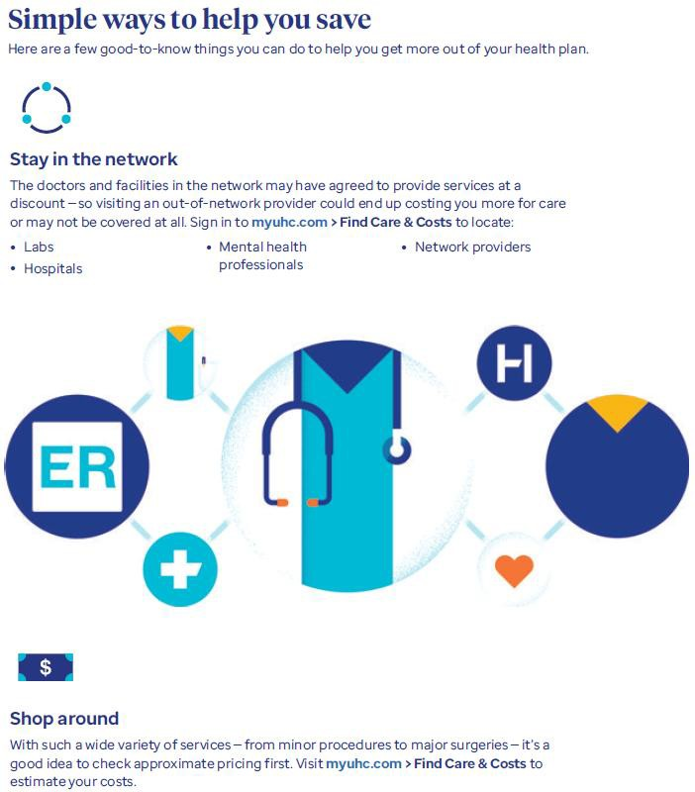

Slide 13
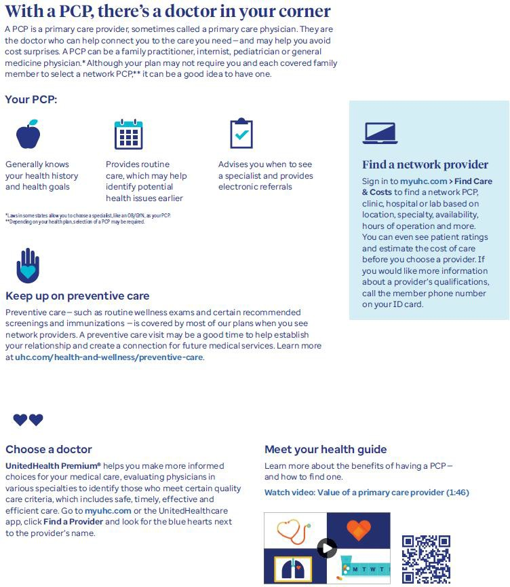

Slide 14
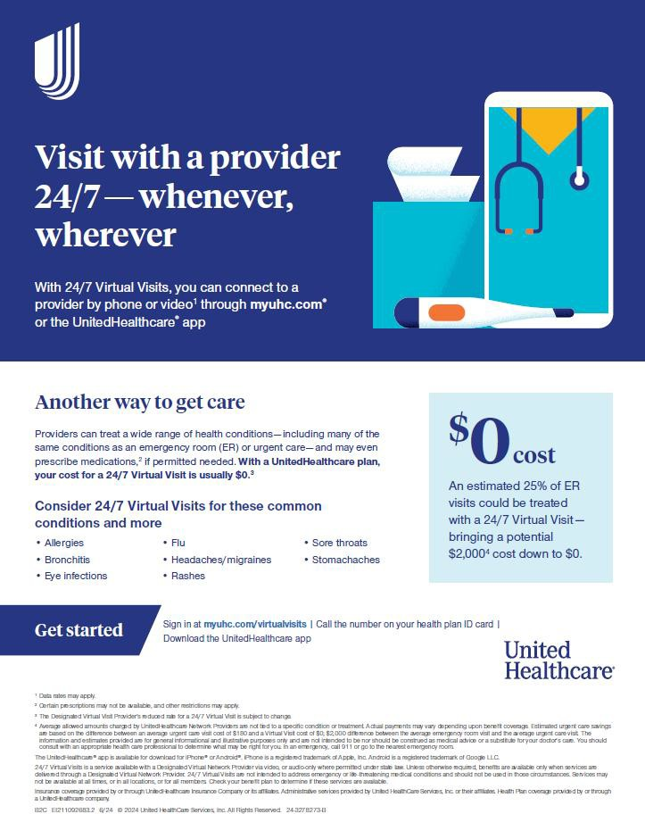

Slide 15
WHEN & WHERE TO ACCESS CARE
Type of Provider | Scenario | Type of Illness or Injury
Primary Care Physician (PCP) | Annual wellness exams, or moderate pain that needs to be diagnosed | General checkup, moderate pain of unknown origin, etc.
Specialist | Experiencing pain specific to a particular region of the body (ie: muscular, gastrointestinal, ocular, bone/joint, skin, ears/nose/throat, etc.) | Ulcers, rash, digestive problems, vision problems, elevated test levels, etc.
24-Hour Nurse Line | Talk with a registered nurse - available 24 hours a day/ 7 days a week | Non-emergency medical scenarios in which you are trying to decide if you need to go to the doctor or not
Teladoc | Virtual doctor's appointments available 24/7 for general medical, mental health and dermatology issues | Non-emergency medical scenarios conditions like flu, sinus infections, sore throats, eczema, acne, rashes; Access to mental health therapists 7 days a week 7am-9pm
Walk-In Clinic | Treatment of unscheduled, non-emergency illnesses/injuries and certain immunizations | Vaccination, mild cold/flu, minor cuts/ abrasions, etc.
Urgent Care (Alternative to ER) | Treatment of most non-life threatening emergencies | Broken bones (not multiple fractures), minor wounds (not bleeding profusely), mild fever, flu, acute sinusitis, etc.
Emergency Room (ER) | Treatment of all life/limb-threatening emergencies | Severe head trauma, multiple/compound fractures, heavy bleeding, elevated fever, severe burns, seizures, poison, etc.
Hospital | Having an inpatient or outpatient procedure performed, in a critical state | Delivering a baby, major/minor surgery, recovery, monitoring, etc.

Slide 16

MEDICAL PLAN WELLNESS PROGRAMS
UHC Rewards
With UHC Rewards, a variety of actions — including things you may already be doing, like tracking your steps or sleep — lead to rewards. The activities you go for are up to you, and the same goes for ways to spend your earnings.
Digital Tools
Register at myUHC.com or download the UnitedHealthcare app to view benefit information, search for in-network providers, access your medical ID card, learn about covered preventive care and compare cost estimates.
Real Appeal
Real Appeal is a proven weight management program designed to help you get healthier and stay healthier. It’s available to you at no additional cost as part of your benefits. Set achievable nutrition, exercise and weight management goals that keep you motivated to create lasting change. Track your progress from your daily dashboard, too.
Quit For Life
If you use tobacco and have thought about quitting, Quit For Life® on Rally Coach may be able to help. Get tools and online resources designed to help you quit — and stay quit — at no additional cost.
One Pass Select
With One Pass Select®, we’re on a mission to make fitness engaging for everyone. One Pass Select can help you reach your fitness goals while finding new passions along the way. Find a routine that’s right for you whether you work out at home or at the gym. Choose a membership tier that fits your lifestyle and provides everything you need for whole body health in one easy, affordable plan.
Employee Assistance Program (EAP)
Your Employee Assistance Program (EAP) offers access to personalized support, resources and no-cost referrals. It’s confidential 1-on-1 help from a master’s-level specialist.
Optum Prescription (Rx) Home Delivery
With Optum® Home Delivery, you can get a 3-month supply of your long-term medications. Plus, they are mailed to you with free standard shipping. Use the website and app any time to track orders, request refills, price medications and more. Pharmacists and customer support team are available 24/7.
Calm Health App
The Calm Health app provides programs and tools to help support your mental health and well-being — all at your own pace. As a UnitedHealthcare member, Calm Health is included in your health plan and available at no additional cost. The Calm Health app brings you a library of support — including mindfulness content and programs created by psychologists — for a variety of health experiences and life stages.
Please Note: PDFs with additional information on these programs can be found under Wellness Programs on the Gallagher-hosted NU Postdoc Benefit Program homepage.

Slide 17

EMPLOYEE ASSISTANCE PROGRAMS (EAPs)
SupportLinc
SupportLinc is Northwestern's Employee Assistance Program (EAP) provider. The EAP is available to faculty, staff and household members, and provides 24/7 free and confidential access to a variety of mental health and well-being services and resources, including short-term counseling. Contact wellbeing@northwestern.edu with questions, and feel free to visit the EAP site for more information.
Employee Assistance Program (EAP)—offered by UnitedHealthcare
An additional feature of the UnitedHealthcare medical insurance is the Employee Assistance Program (EAP), which offers postdocs and their immediate family members confidential, 24/7 access to professional counselors who can help with a wide variety of life challenges and concerns including relationships at home, issues at work and more. The EAP helps you and your family with a range of issues, including: Identifying resources for managing stress, anxiety and depression Offering specialized help in improving relationships at home or work Providing guidance on legal and financial concerns Finding ways to help you cope with occupational stress and burnout Connecting you with care for addressing substance use issues Members receive 3 free counseling sessions per incident, per year. For more information or to access the resources available through the EAP, call 888-887-4114.
17

Slide 18

DENTAL PLAN OPTIONS
 | HMO
 | In-Network
Core Benefits | Postdoc Pays
Annual Deductible | None
Annual Benefit Maximums | Unlimited
PREVENTIVE/DIAGNOSTIC
Routine Exam | $0
Teeth Cleanings (Prophylaxis) | $0
X-rays | $0
BASIC PROCEDURES
Fillings | Varies up to $63 Copay
Endodontics | Varies up to $400 Copay
Periodontics | Varies up to $231 Copay
Oral Surgery | Varies up to $259 Copay
MAJOR PROCEDURES
Crowns | Varies up to $511 Copay
Dentures | Varies up to $709 Copay
ORTHODONTIA
Child | $3,070 Copay*
Adult | $3,430 Copay*
PPO
In-Network | Out-of-Network
Postdoc Pays
$50 / $150
$3,000
0% | 0% of UCR
0% | 0% of UCR
0% | 0% of UCR
20%* | 20% of UCR*
20%* | 20% of UCR*
20%* | 20% of UCR*
20%* | 20% of UCR*
50%* | 50% of UCR*
50%* | 50% of UCR*
Child Only—50%* ($3,000 lifetime max) | Child Only—50% of UCR* ($3,000 lifetime max)
*Does not include start-up and retention fees
*After deductible has been met
Accessing Out-of-Network Care Under a PPO Plan
When you seek services in-network, meaning from providers listed in the PPO network, you pay less for care. When you pay 50% for major services from an in-network PPO dentist, you are paying 50% of a contracted, discounted rate. This is not the case with out-of-network providers. Out-of-Network Example: The out-of-network dentist charges $1,000 for a porcelain crown on a molar. This dentist can charge whatever they want for this service. Your percentage of the cost for out-of-network care is 50% after the $50 deductible. For this service (a crown), the Usual, Customary and Reasonable (UCR) cost is $800, so you pay $425. IN ADDITION, you owe the difference between the UCR amount and the dentist’s charge ($1,000 -$800), which is an additional $200. Total estimated cost out-of-network for the porcelain crown on a molar: $625
What is a Usual, Customary and Reasonable (UCR) Charge?
Usual, customary and reasonable charges are set by the insurance company, based on the prevailing cost of a service in your geographic area. The insurance company then determines how much it will pay for a given service in your area. To educate yourself on the cost of any service before having those services rendered, ask your dentist for a “pre-treatment estimate.”
18

Slide 19


VISION PLAN
 | In-Network | Out-of-Network
Core Benefits | Postdoc Pays
Vision Examinations | $10 Copay | $40 Allowance
 | Every 12 Months
Corrective Lenses | $10 Copay | $30 - $70 Allowance
Conventional Contact Lenses* | $200 Allowance (15% off remaining balance) | $140 Allowance
Medically Necessary Contact Lenses* | $0 Copay | $210 Allowance
 | Every 12 Months
Frames | $200 Allowance (20% off remaining balance) | $140 Allowance
 | Every 12 Months
*Materials only; In lieu of corrective glasses
Additional Features
Eye Care Supplies: Receive 20% off retail price for eye care supplies like cleaning cloths and solutions purchased at in-network providers (not valid on doctor's services or contact lenses).
Laser Vision Correction: Save 15% off retail price or 5% off the promotional price for LASIK or PRK procedures.
Replacement Contact Lens Purchases: Visit www.eyemedcontacts.com to order replacement contact lenses at less than retail price.
19

Slide 20

LIFE | AD&D PLAN
Core Benefits | Life and AD&D*
Basic Life | $50,000
Accidental Death & Dismemberment | $50,000
*Automatic enrollment, paid for by the University (with the exception of Direct Postdocs)
What is Life and AD&D Insurance?
Basic Life insurance helps provide financial protection in the event of an eligible member’s covered death. Basic Accidental Death and Dismemberment (AD&D) insurance may provide an additional amount in the event of a covered death or dismemberment as a result of an accident.
Additional Features
AD&D Seat Belt Benefit: Up to $10,000 is payable for death as a result of a car accident while wearing a seat belt.
AD&D Airbag Benefit: Provides further protection in the event of a covered automobile accident for which an AD&D Seat Belt Benefit is payable. The amount of the Air Bag Benefit is the lesser of (1) $5,000; or (2) the amount of AD&D Insurance Benefit payable for loss of your life.
AD&D Family Benefits: Includes benefits for career adjustment, childcare, and higher education for eligible surviving family members. Review the Life/AD&D Summary Plan Description in the Plan Documents Library for additional details.
Designating Your Beneficiary(ies)
A beneficiary is the person or people who will receive your life insurance benefit in the event of your passing. A contingent beneficiary is the person or people who will receive the benefit if the primary beneficiaries have predeceased the insured. Your beneficiary(ies) should be designated on your enrollment form.
Please Note: International postdocs holding a J-1 visa (and their J-2 dependents) DO NOT need to purchase supplemental medical evacuation and repatriation coverage to meet J-1 and J-2 visa requirements. The Life/ AD&D plan satisfies these requirements, even if the postdoc waives the medical, dental and vision coverage.

Slide 21

INCOME PROTECTION—EMPLOYEE POSTDOCS
Extended Sick Time (EST)—Employee Postdocs Only
This program is available only to employee postdocs (not NRSA or direct postdocs), and takes the place of a traditional Short-Term Disability (STD) plan. Eligible postdocs are automatically enrolled in EST six months from their original benefits-eligible hire date. No enrollment is required.
If you experience an accident or illness, you must file an EST claim and meet the following criteria to receive the benefit: absent from work due to a disability for seven consecutive calendar days eligible for the EST program based on six months of continuous benefits-eligible service
Benefits are available for a period of up to 25 weeks. The EST program is provided at no cost to you.
Long-Term Disability (LTD) Insurance—Employee Postdocs Only
The LTD plan, offered by The Hartford, provides you a way to protect your income if you become disabled for a lengthy period of time.
The LTD plan provides a monthly benefit if you are unable to perform your regular job (during the first two years of your disability) or any reasonable job (after two years of disability) due to illness or injury. The Core plan provides 50% of an employee's last working University salary up to a maximum benefit of $11,500 per month. The Buy-up plan provides 60% of an employee's last working University salary up to a maximum benefit of $13,800 per month. The Core LTD Plan is provided at no cost to you; the Buy-up LTD plan must be elected during Open Enrollment or Initial Enrollment in the MyHR system. For more information: Long Term Disability: Human
Resources - Northwestern University
Please Note: This benefit is administered by Northwestern Human Resources.

Slide 22
INCOME PROTECTION—NRSA & DIRECT PAY POSTDOCS
Short-Term Disability (STD) Insurance—NRSA & Direct Postdocs Only
What is STD Insurance? The STD plan, offered by The Standard, provides you a way of protecting your income if you become disabled for a period of time and are not eligible for the extended sick time benefit.
It is important to have protection for your income to allow you to meet your financial obligations when you are unable to work; disability insurance does just that. STD insurance is provided at no cost to you.
Core Benefits | Short-Term Disability (STD)
Benefit Amount | 60% of your pre-disability earnings
Benefit Waiting Period | Payable after 7 days of continued disability
Maximum Benefit Period | 173 days
Pre-existing Conditions | Ailments diagnosed/treated during the 3 months prior to enrollment will not be covered until the plan has been active for 12 months.
Long-Term Disability (LTD) Insurance—NRSA & Direct Postdocs Only
What is Long-Term Disability Insurance? The LTD plan, offered by The Standard, provides you a way to protect your income if you become disabled for a lengthy period of time.
It is important to have protection for your income to allow you to meet your financial obligations when you are unable to work; disability insurance does just that. LTD insurance is provided at no cost to NRSA postdocs and is available to direct postdocs.
Core Benefits | Long-Term Disability (LTD)
Benefit Amount | 50% of your pre-disability earnings
Benefit Waiting Period | Payable after 180 days of continued disability
Maximum Benefit Period | Until member reaches Social Security Normal Retirement Age
Pre-existing Conditions | Ailments diagnosed/treated during the 3 months prior to enrollment will not be covered until the plan has been active for 12 months.
Please Note: If you leave the United States to permanently return to your home country, your Long-Term Disability benefits will terminate 12 months from the date you departed the United States.

Slide 23
VOLUNTARY LIFE INSURANCE
Core Benefits | Postdoctoral Voluntary Life Insurance
Benefit Amount | 1, 2, 3, 4 or 5 times your annual salary up to $500,000
Guaranteed Issue | $150,000 (amounts in excess require a medical questionnaire and approval)
Core Benefits | Spouse Voluntary Life Insurance
Benefit Amount | Available in units of $10,000 to a maximum of $250,000 (amount not to exceed 100% of postdoc voluntary life amount)
Guaranteed Issue | $30,000 (amounts in excess require a medical questionnaire and approval)
Core Benefits | Child Voluntary Life Insurance
Benefit Amount | Available in units of $1,000 to a maximum of $10,000 (amount not to exceed 100% of postdoc voluntary life amount)
Eligibility Requirements | “Child” means your unmarried child from live birth through age 20 (through 24 if a registered full-time student)

Slide 24
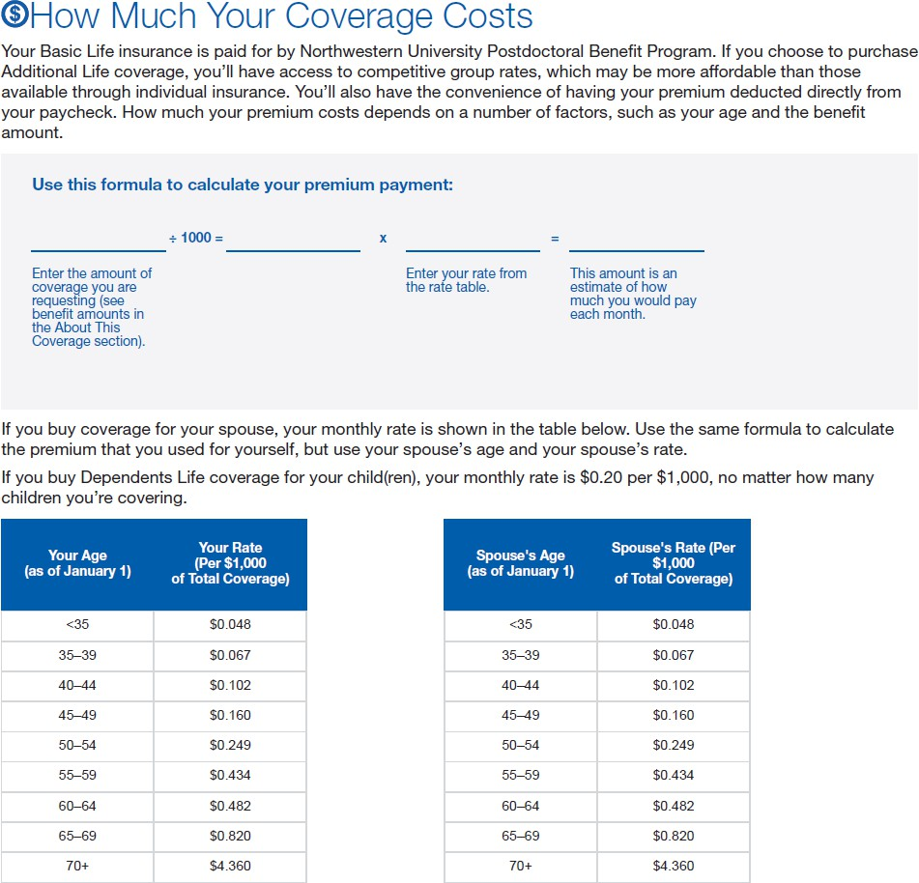
VOLUNTARY LIFE INSURANCE RATES
Monthly Rate Calculation
Please use the tables and instructions below to calculate your monthly premium due for the coverage(s) you would like to elect. Feel free to contact our office if you require any assistance.

Slide 25

HEALTHCARE FLEXIBLE SPENDING ACCOUNT (FSA)
Healthcare FSA
You can save money when you use tax-free dollars from a Health Care Flexible Spending Account (Health Care FSA) to pay eligible health care expenses incurred by you, your spouse or your dependent child(ren). Note: You do not need to be enrolled in a Northwestern-sponsored medical plan to participate in a Health Care FSA. If you are an NRSA or other direct postdoc, tax restrictions prevent the University from offering you pre-tax deductions. You can contribute up to $3,400 a year to your account. The minimum annual contribution is $240. If you choose to contribute to a Health Care FSA: Once your enrollment takes effect, you will not be able to change your pre-tax contributions to the account until the next Open Enrollment period unless you experience a qualifying life event. You can be reimbursed for eligible health care expenses up to the full value of the pre-tax contributions you’ve agreed to make for the year from the first day of the benefit year – even before all scheduled contributions for the year have been made. You can use the money you contribute to a Health Care FSA each year to pay eligible expenses incurred in the calendar year (January 1-December 31) in which they are made, as well as eligible expenses incurred January 1-March 15 of the following calendar year (the grace period). The deadline for submitting claims is March 31 of the year following the calendar year in which the contributions are made. You will forfeit any unused contributions in a Health Care FSA not used by the claim filing deadline. Funds in your Health Care FSA are not “portable” if you retire or leave Northwestern.
Please Note: This benefit is not administered by Gallagher Benefits Services. Please contact Northwestern Human Resources for additional information.
Please Also Note: You must renew your election to make pre-tax contributions to a Health Care FSA each
year during Open Enrollment. If you don’t, your Health
Care FSA pre-tax contribution amount for the next year will default to $0.
25

Slide 26
DEPENDENT CARE
Benefit Eligibility
If you are a non-NRSA postdoc on the University payroll, you are eligible for a dependent care FSA via Inspira with a University match up to $4,000. If you are an NRSA or other direct postdoc, tax restrictions prevent the University from offering you pre-tax deductions. Instead, you are eligible for a dependent care grant from the University (up to $4,000) subject to the same parameters laid out in the Dependent Care FSA description. Use this link to apply: https://onbase-sso.northwestern.edu/form/hr-ops-integrate-benefits-form.
Dependent Care FSA
If you are a non-NRSA postdoc on the University payroll, you can save money when you use tax-free dollars from a Dependent Care Flexible Spending Account (Dependent Care FSA) to pay eligible dependent care expenses. Your qualified dependents may include your children through age 12, or spouse, parents, in-laws, siblings, or child(ren) over the age of 13 incapable of self-care. Those covered must be declared as a dependent on your tax return. If you are single or married filing taxes jointly, you may contribute up to $7,500 per household (single or married filing jointly) and $3,750 per year for married individuals filing separately to a Dependent Care FSA. The minimum annual contribution is $240. If you choose to contribute to a Dependent Care FSA: Once your enrollment takes effect, you will not be able to change your contribution to that account until the next enrollment period unless you experience a qualifying life event. You can be reimbursed for eligible dependent care expenses up to your current account balance ONLY. Any expenses in excess of your current account balance will be reimbursed as additional contributions are added to your account throughout the year. You can use the money you contribute to a Dependent Care FSA each year to pay eligible expenses incurred in the calendar year (January 1-December 31) in which they are made. The deadline for submitting claims is March 31 of the year following the calendar year in which the contributions were made. To submit a request for reimbursement, you must complete a Inspira claim form and submit it to Inspira. You will forfeit any unused contributions in a Dependent Care FSA at year end. Funds in your Dependent Care FSA are not “portable” if you retire or leave Northwestern. Eligible dependent care expenses you can reimburse using pre-tax dollars from a Dependent Care FSA include: Summer Sports/ Day camp and camp activities. Please note: Overnight Camp is NOT an eligible expense. Day care for your child(ren). Day care for an elderly or disabled dependent. Nanny salary and taxes.
Please Note: These benefits are not administered by Gallagher Benefits Services. Please contact Northwestern Human Resources for additional information.

Slide 27

DEPENDENT CARE
Dependent Care University Grant
Postdocs eligible for the FSA are also eligible for matching funds from the University for their Dependent Care FSA. Based on the postdoc’s household earnings, the University will provide a contribution to the dependent care FSA plan based on the chart below. Please note: You must apply annually in order to receive University funds. Late enrollments will be prorated. Use the link below to apply. https://onbase-sso.northwestern.edu/form/hr-ops-integrate-benefits-form
Household Earnings | Northwestern Election Match (%) | Maximum Contribution
Up to $60,000 | 80% | $4,000 per year
$60,001—$75,000 | 60% | $3,000 per year
$75,001—$100,000 | 40% | $2,000 per year
$100, 001—$150,000 | 20% | $1,000 per year
Please Note: Postdocs funded by an NRSA grant are not eligible for pre-tax deductions and matching. Instead, the University offers these postdocs an equivalent dependent care grant of up to $4,000 to be used on eligible expenses as described under the FSA. NRSA postdocs are also eligible for childcare support from the NIH. Please
speak to your grant administrator for more information.
Please Also Note: These benefits are not administered by Gallagher Benefits Services. Please contact Northwestern Human Resources for additional information.

Slide 28
OTHER BENEFITS
Eligibility for Other Benefits
If you are considered a University-employed postdoc, meaning you are paid a salary (not a stipend) by the University or from a PI’s grant, you qualify for the following benefits below. Postdocs funded by NRSA grants and other fellowships should check with the NIH or their funding agency for relevant guidelines.
LegalEASE (for Employee Postdocs only)
LegalEASE offers a legal insurance plan that provides support and protection for personal legal issues, including: Home and consumer (Buying, selling, foreclosure and tenant disputes) Financial (Debt collection, collections, contracts) Auto and traffic (Traffic matters and license suspensions) Family (Adoption, divorce, name change) Estate planning and wills (Will, living will, health care power of attorney) Benefits are designed to meet the typical needs of a employees and their family. There are no deductibles for covered services. Benefits cover the attorney’s time. Other costs such as filing fees or court costs are not covered. Listed on the LegalEASE website are the types of matters that are covered by the LegalEASE benefits plan. Enrollment for LegalEASE is done through the myHR portal during Open Enrollment.
Retirement 403(b)
Employee postdocs, with a primary job code of 100006 or 100118, are eligible for Northwestern’s Voluntary Savings Plan and Retirement Plan. More information on eligibility can be found on the Retirement Website.
Please Note: These benefits are not administered by Gallagher Benefits Services. Please contact Northwestern Human Resources for additional information.

Slide 29

OTHER BENEFITS
Tuition Benefits
Full-time employee postdocs, with a primary job code of 100006 or 100118, are eligible for Northwestern’s tuition benefits. More information on eligibility can be found on the Tuition Website.
Paid Time Off Benefits
Employee postdocs, with a primary job code of 100006 or 100118, are eligible for vacation, holiday, personal floating holiday, and sick time, as well as Winter Recess. More information on eligibility can be found on the Time-of f Website. NRSA postdocs, please refer to NIH grant notice on leaves including vacation and parental leaves.
Commuter Transit
Employee postdocs, with a primary job code of 100006 or 100118, are eligible for pre-tax commuter benefits. More information on eligibility can be found on the Commuter Transit Website.
PerkSpot: Life’s Better with a Discount!
Northwestern has partnered with PerkSpot to offer faculty, staff, postdocs and their family members discounts from 900+ merchants nationwide. When you register with PerkSpot you can access discounts and exclusive offers on a wide range of goods and services, including: Buying a new car – from Ford, Lincoln, Nissan, Infinity and Volkswagen Cell phone discounts – from AT&T, Sprint and Verizon Computer discounts – on Dell, Hewlett Packard and CDW products Can I touch sheets in a little bit Gifts – including Fannie Mae candy and For You Flowers Movie tickets – at AMC Chicago sports tickets – for the Bulls and White Sox Fitness discounts – at GlobalFit, FFC and East Bank Club Real estate and moving discounts
Pet Insurance (available to all postdocs)
Northwestern is excited to offer pet insurance for your dogs and cats! Now more than ever, pets are playing a significant role in our lives and it’s even more important to keep them safe and healthy. Help protect you and your furry family members against unplanned vet expenses for covered accidents or illnesses with MetLife Pet Insurance. To enroll, contact
Please Note: These benefits are not administered by Gallagher Benefits Services. Please contact Northwestern Human Resources for additional information.

Slide 30
EMPLOYED POSTDOC RATES AND CONTRIBUTIONS
 | Monthly Postdoc Cost
Medical HMO
Postdoc | $84.00
Postdoc + Spouse/Partner | $162.00
Postdoc + Child(ren) | $155.00
Family | $241.00
Medical PPO
Postdoc | $92.00
Postdoc + Spouse/Partner | $179.00
Postdoc + Child(ren) | $172.00
Family | $266.00
Dental HMO
Postdoc | $9.00
Postdoc + Spouse/Partner | $15.00
Postdoc + Child(ren) | $16.00
Family | $23.00
Dental PPO
Postdoc | $23.00
Postdoc + Spouse/Partner | $49.00
Postdoc + Child(ren) | $55.00
Family | $78.00
Vision
Postdoc | $8.53
Postdoc + Spouse/Partner | $16.21
Postdoc + Child(ren) | $17.06
Family | $25.08
Life Insurance ($50K) | $0.00
Long-Term Disability (LTD) | $0.00
Extended Sick Time (EST) | $0.00
Voluntary Life (postdoc, spouse, child) | See plan summaries in Documents Library for calculation

Slide 31
NRSA POSTDOC RATES AND CONTRIBUTIONS
 | Monthly Postdoc Cost
Medical HMO
Postdoc | $0.00
Postdoc + Spouse/Partner | $205.64
Postdoc + Child(ren) | $167.90
Family | $391.35
Medical PPO
Postdoc | $0.00
Postdoc + Spouse/Partner | $222.00
Postdoc + Child(ren) | $179.34
Family | $420.84
Dental HMO
Postdoc | $0.00
Postdoc + Spouse/Partner | $6.81
Postdoc + Child(ren) | $7.93
Family | $14.73
Dental PPO
Postdoc | $0.00
Postdoc + Spouse/Partner | $26.08
Postdoc + Child(ren) | $32.30
Family | $56.02
Vision
Postdoc | $0.00
Postdoc + Spouse/Partner | $8.10
Postdoc + Child(ren) | $7.95
Family | $9.23
Life Insurance ($50K) | $0.00
Long-Term Disability (LTD) | $0.00
Short-Term Disability (STD) | $0.00
Voluntary Life (postdoc, spouse, child) | See plan summaries in Documents Library for calculation

Slide 32
DIRECT POSTDOC RATES AND CONTRIBUTIONS
 | Monthly Postdoc Cost
Medical HMO
Postdoc | $587.77
Postdoc + Spouse/Partner | $1,136.14
Postdoc + Child(ren) | $1,090.29
Family | $1,686.85
Medical PPO
Postdoc | $648.85
Postdoc + Spouse/Partner | $1,254.21
Postdoc + Child(ren) | $1,203.60
Family | $1,862.14
Dental HMO
Postdoc | $18.15
Postdoc + Spouse/Partner | $32.90
Postdoc + Child(ren) | $34.04
Family | $49.92
Dental PPO
Postdoc | $49.75
Postdoc + Spouse/Partner | $108.21
Postdoc + Child(ren) | $121.89
Family | $172.89
Vision
Postdoc | $8.53
Postdoc + Spouse/Partner | $16.21
Postdoc + Child(ren) | $17.06
Family | $25.08
Life Insurance ($50K) | $4.95
Long-Term Disability (LTD) | $5.56
Short-Term Disability (STD) | $24.14
Voluntary Life (postdoc, spouse, child) | See plan summaries in Documents Library for calculation

Slide 33

INFORMATION SOURCES
Insurance Carrier Member Services
UnitedHealthcare Medical……………………………...…………………. | HMO— (855) 828-7715 PPO — (866) 633-2446
Guardian Dental……………………………….………………………………… | HMO—(866) 494-4542 PPO—(800) 541-7846
EyeMed Vision……………………………………………………………………. | (866) 723-0514
The Standard Basic Life/AD&D……………………………………………. | (800) 628-8600
The Hartford (file an EST claim)…………………………………………… | (888) 541-7283
Gallagher Benefit Services (GBS)
Phone…………………………………………………………………………………. | (949) 317-5917
Email…………………………………………………………………………………… | UniversityServices.GBS.nupfbp@ajg.com
Postdoctoral Benefit Program Website………………………………. | http://clients.garnett-powers.com/pd/northwesternu/
33

Slide 34

This document is an outline of the coverage proposed by the carrier(s), based on information they provide. It does not include all the terms, coverages, exclusions, limitations, and conditions of the actual contract language. The policies themselves must be read for those details. The intent of this document is to provide you with general information about your postdoc benefit plans. It does not necessarily address all the specific issues which may be applicable to you. It should not be construed as, nor is it intended to provide, legal advice. Questions regarding specific issues should be directed to your dedicated account representative.

